Slide 1
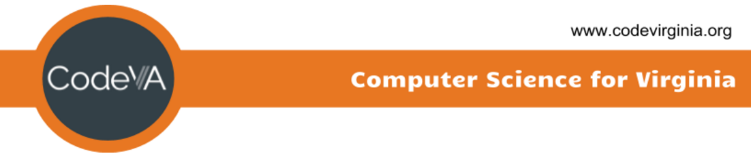
Coding Lesson 3
Loops
Elementary Coaches Academy

Slide 2
Log into your Scratch account
https://scratch.mit.edu

Slide 3
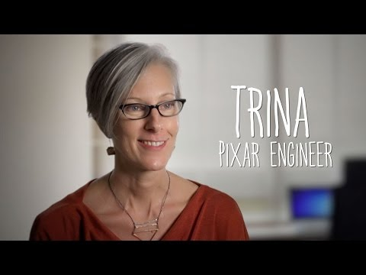

Slide 4

Warm up
Open the starter File
https://scratch.mit.edu/projects/230681049/
Run the program by clicking the flag icon

Slide 5
Warm up
What kind of loop does this use?
When will the loop stop?

Slide 6
Warm up
Change the program so the horse goes all the way across the screen.
Challenge: Make the horse turn around and
go back to the beginning

Slide 7
Definition: Loop
A loop is used to repeat commands in a program

Slide 8

Definition: Repeat loop
This counting loop is used to repeat something an exact number of times.

Slide 9
Definition: Repeat loop
We use these when:
When there is a definite starting and ending point
You know how many times you want the loop to run

Slide 10
Lab Lecture
Add the parrot sprite and the forever loop
Make the parrot fly around randomly in the background

Slide 11

Definition: Forever Loop
This loop runs “forever”
...or until your program is stopped.

Slide 12
Lab Lecture
Discuss: How is the forever loop different than the repeat loop?

Slide 13
Lab Lecture
Change the program so the Forever Loop is a Repeat until.
Stop the parrot when the user hits the spacebar.

Slide 14

Definition: Repeat Until
This loop repeats until a certain condition is met.
Often used to react to user input or events.

Slide 15
Practice
Pick a core subject area (aka, Social Studies) and design a project that you could use with students to reinforce Loops.
Notes:
We need to create practice exercises for teachers to try independently. *mild, Medium, spicy

Slide 16
Journal
Discuss - how can coding be used to reinforce core subject areas?

